Slide 1
AVRDUDE INSTALLATION
Dr.Sreejith Rajan

Slide 2
Download and Setup
Download the appropriate package from
Release AVRDUDE v8.1 · avrdudes/avrdude
Extract the zip file
Copy the folder to C: drive (Windows drive)
Add the folder location to path variables
Advanced Settings
Environment variables
Path
Add new and paste the location
0
1

Slide 3
Upload hex files
Use the following command
avrdude -v -patmega328p -carduino -P COM6 -b115200 -D -U flash:w: ’’yourfile.hex’’:i
0
1

Slide 4
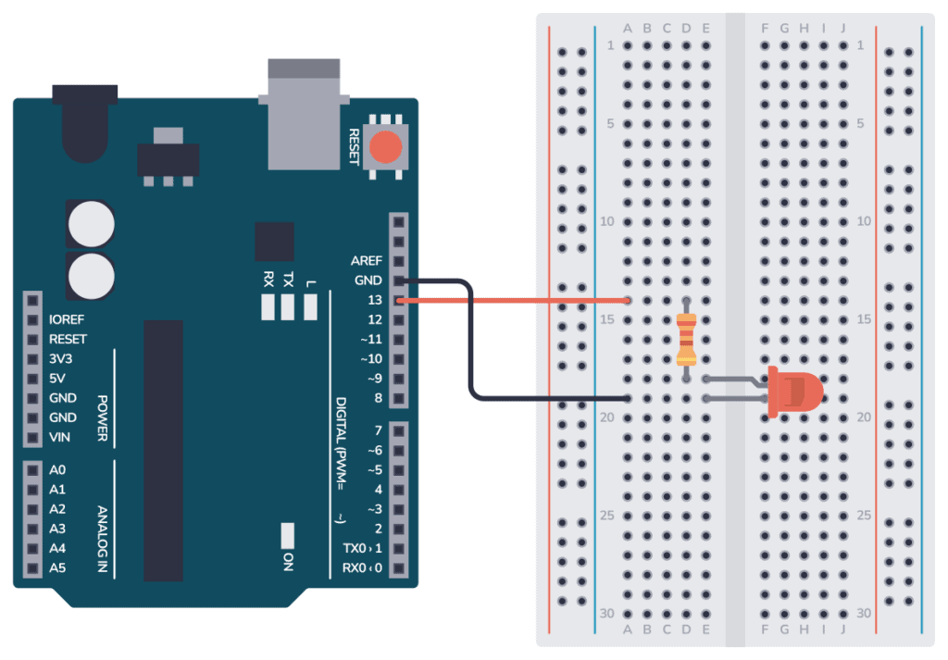
Wiring

Slide 5
THANK YOU

